Slide 1
Power BI
DAX Queries

Slide 2


Slide 3


Slide 4
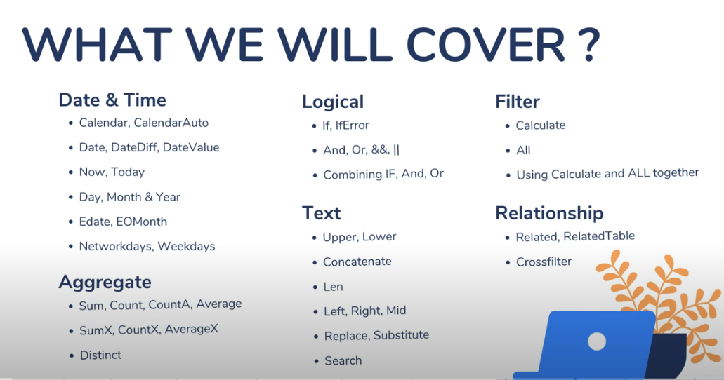

Slide 5
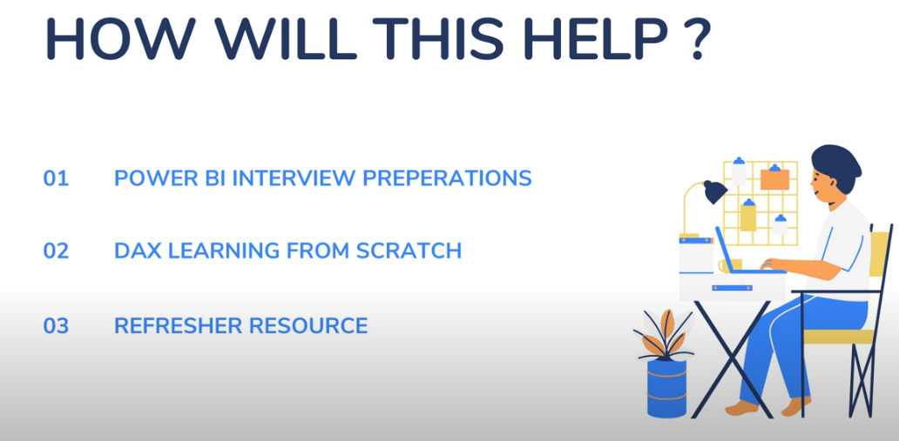

Slide 6


Slide 7
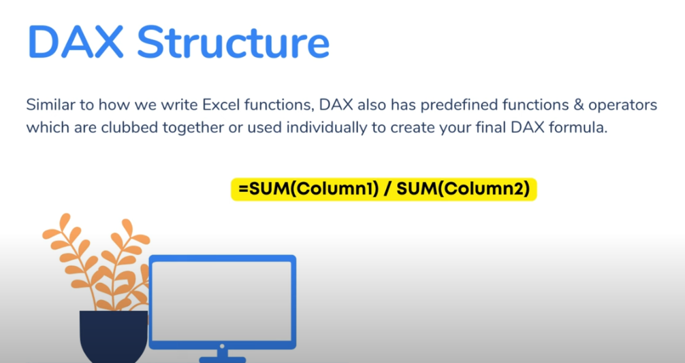

Slide 8
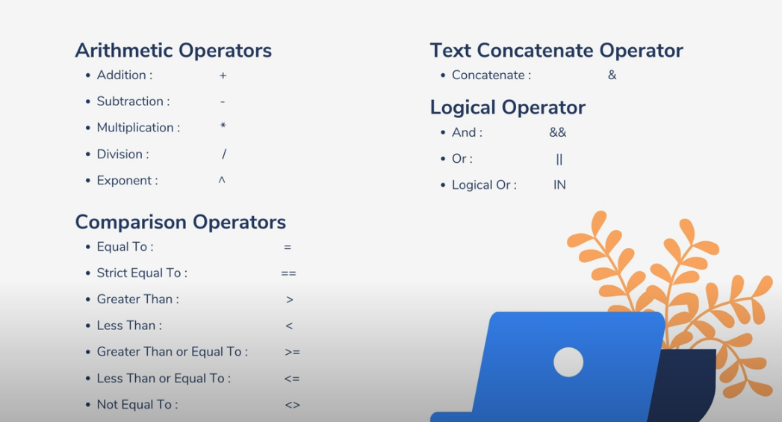

Slide 9
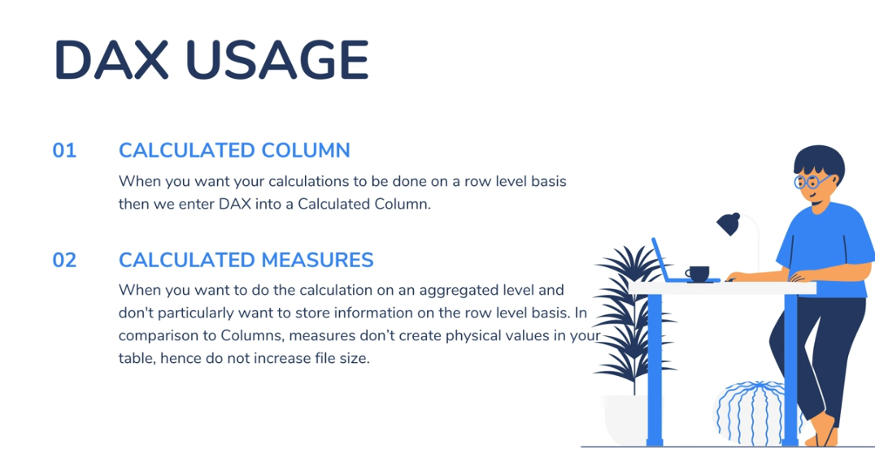

Slide 10
DAX Hands on
How to Create a Calculated Column

Slide 11
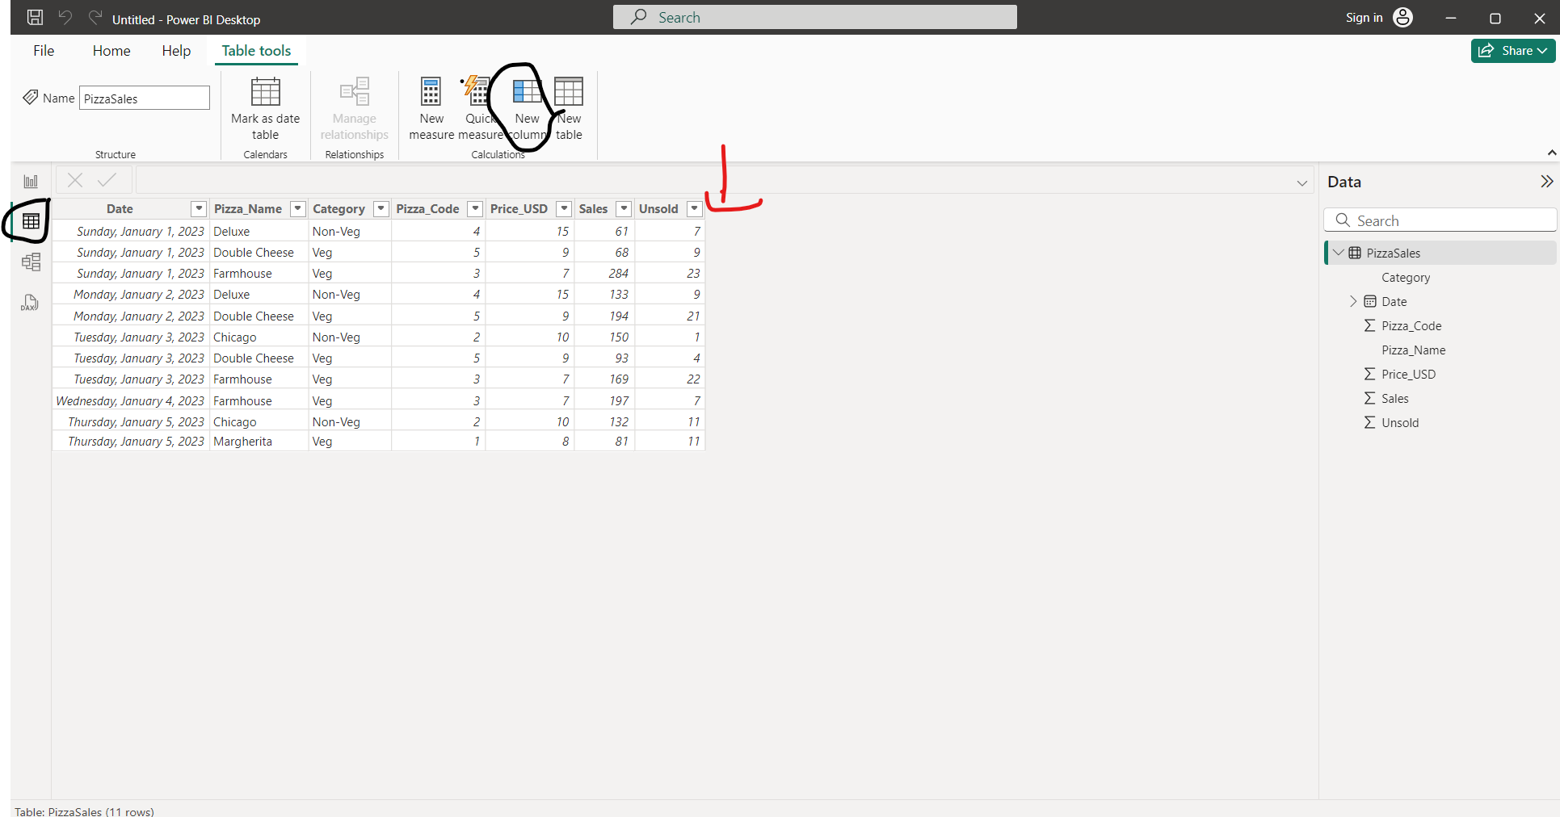
Create a revenue field by adding a new column

Slide 12
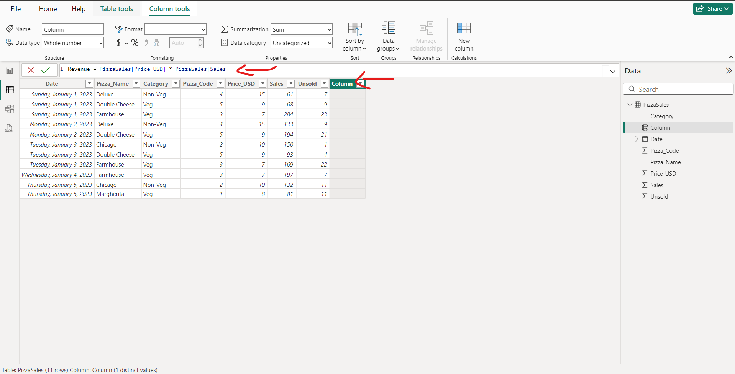
Query Editor write your query formula for Revenue and press Enter

Slide 13
Dax Structure
Table Name
Column Name
Multiplication

Slide 14
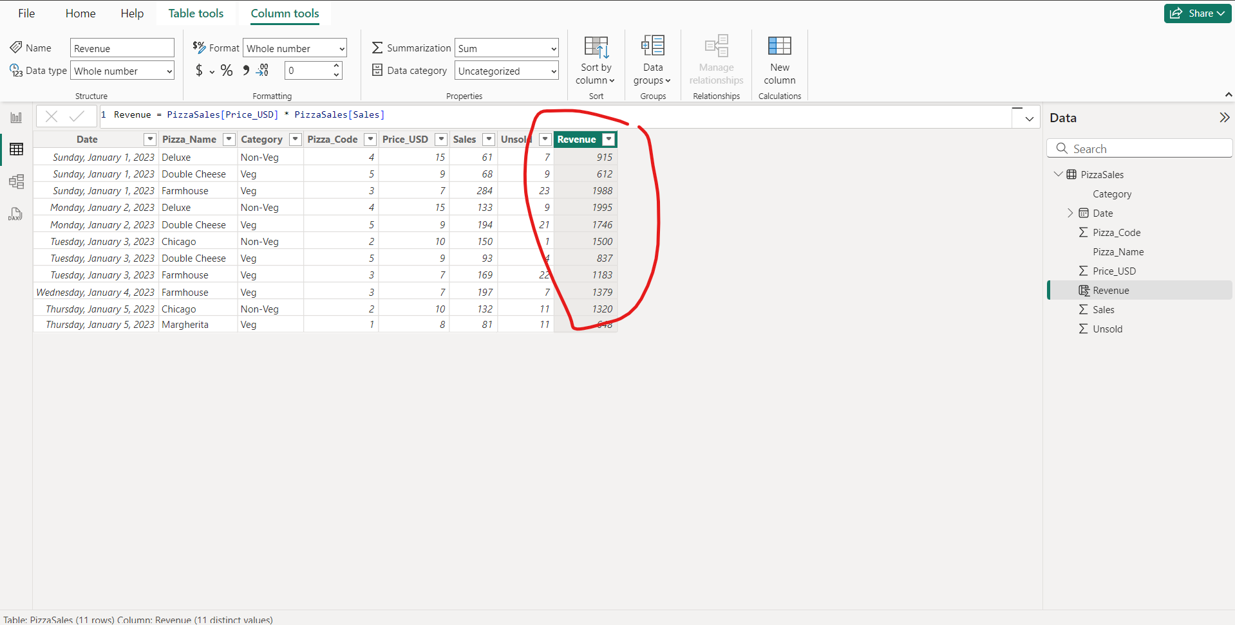
After you press “Enter” Revenue column would be generated with exact calculations

Slide 15
DAX Hands on
How to find Calculated Measure

Slide 16
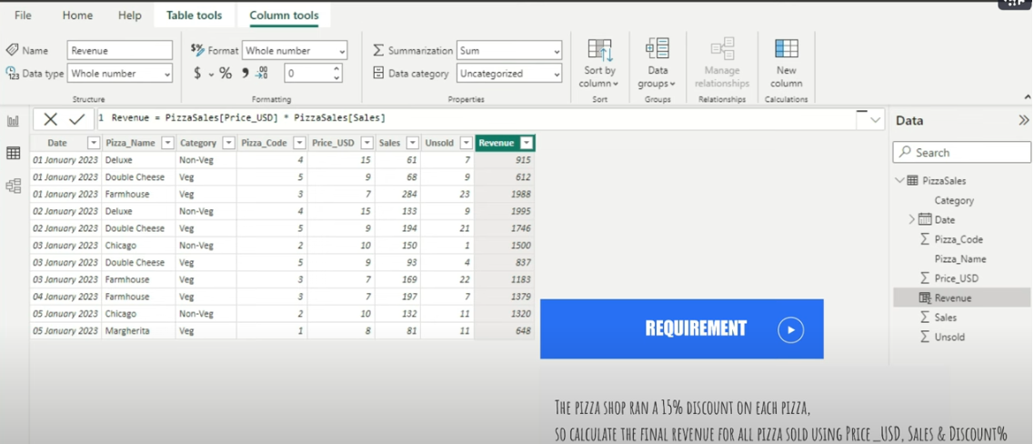
Req: The Pizza Shop ran a 15% discount on each pizza so calculate the final revenue for all pizza sold using Price_USD, Sales and Discount

Slide 17
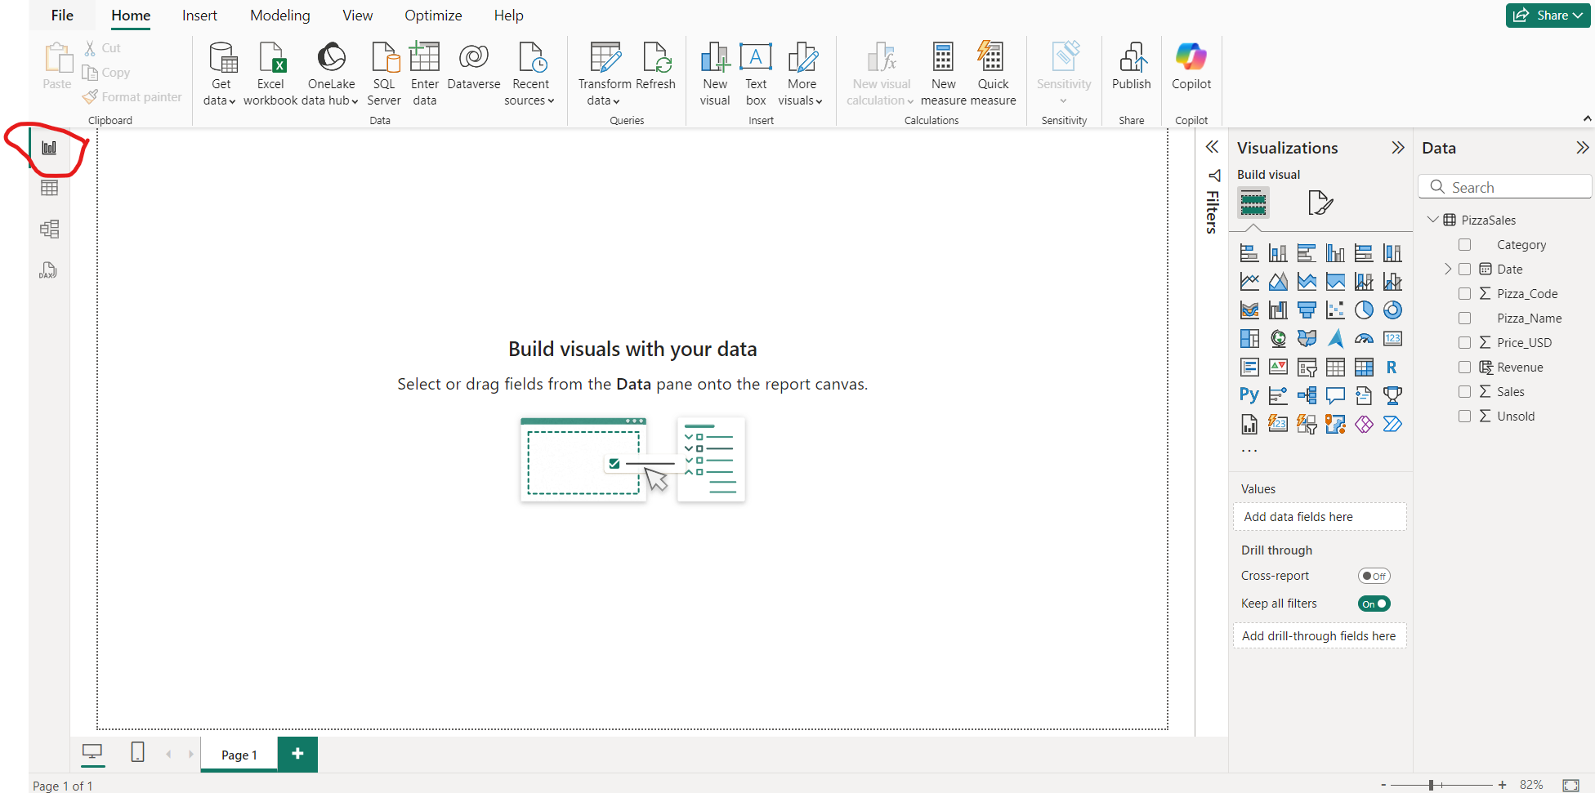
To calculate the “Req” goto report view

Slide 18
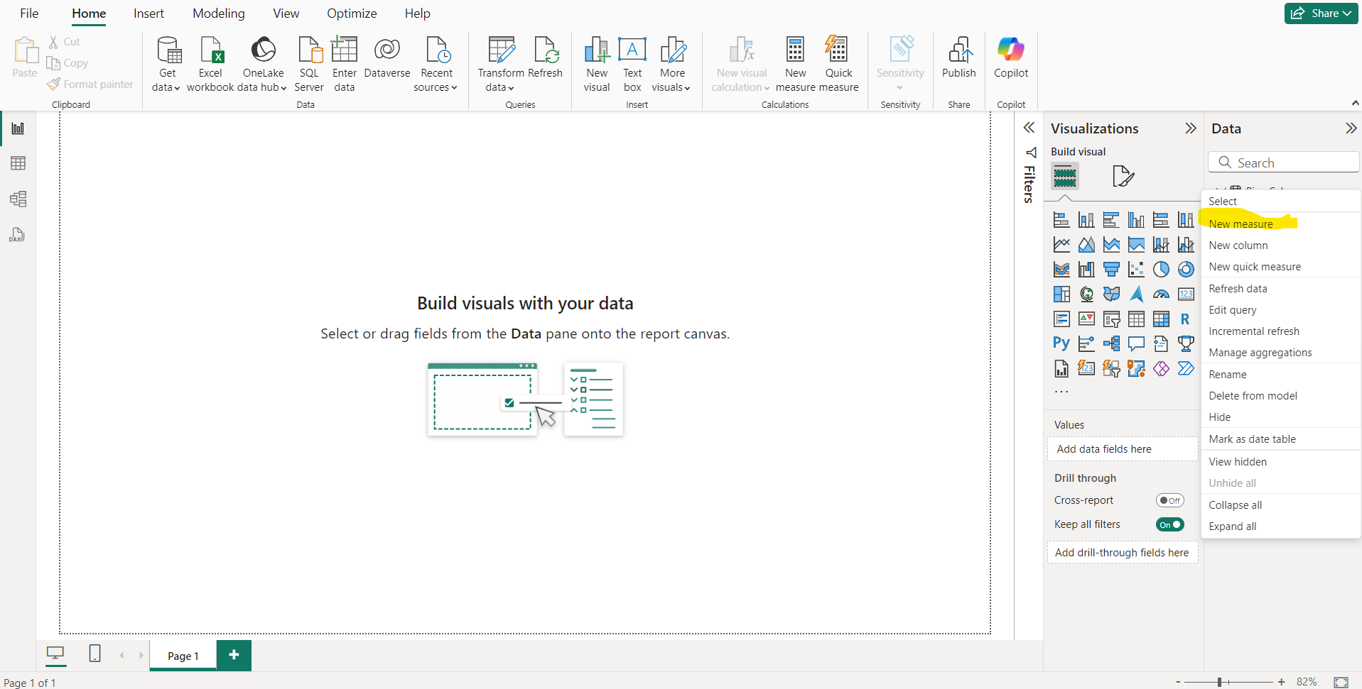
Goto New Measure

Slide 19
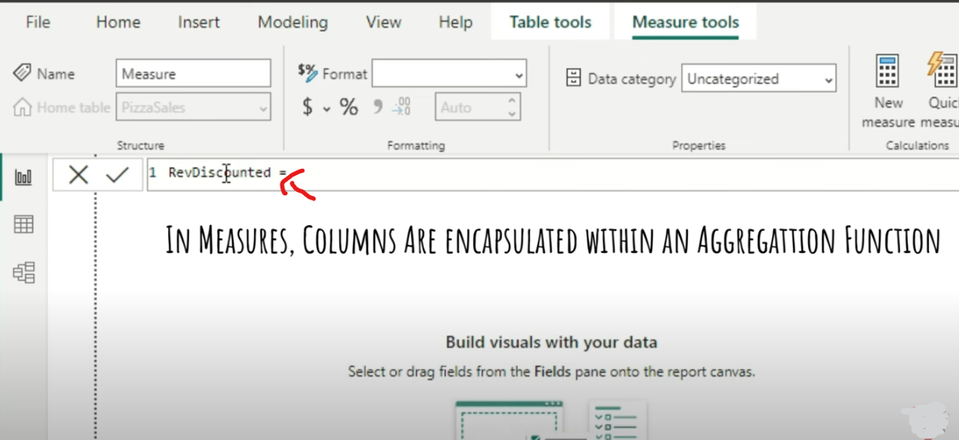
You need to write an aggregation function

Slide 20
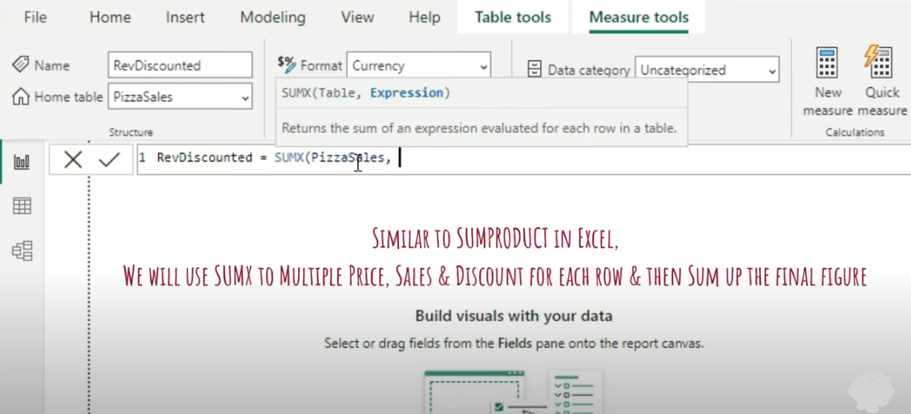
Sumx Formula

Slide 21
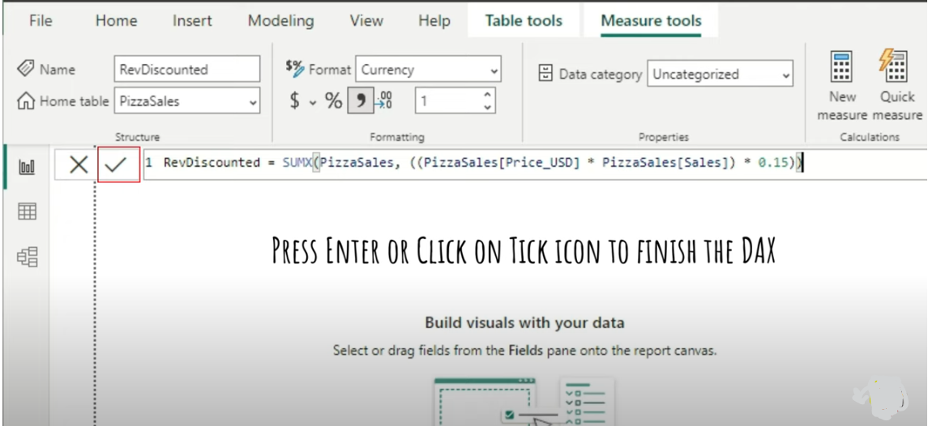
Calc Discounted Revenue Price

Slide 22


Slide 23
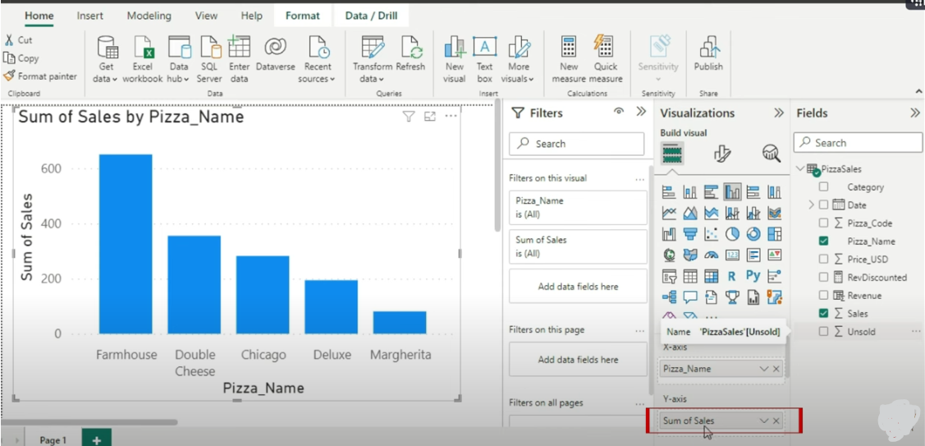
Implicit Example

Slide 24
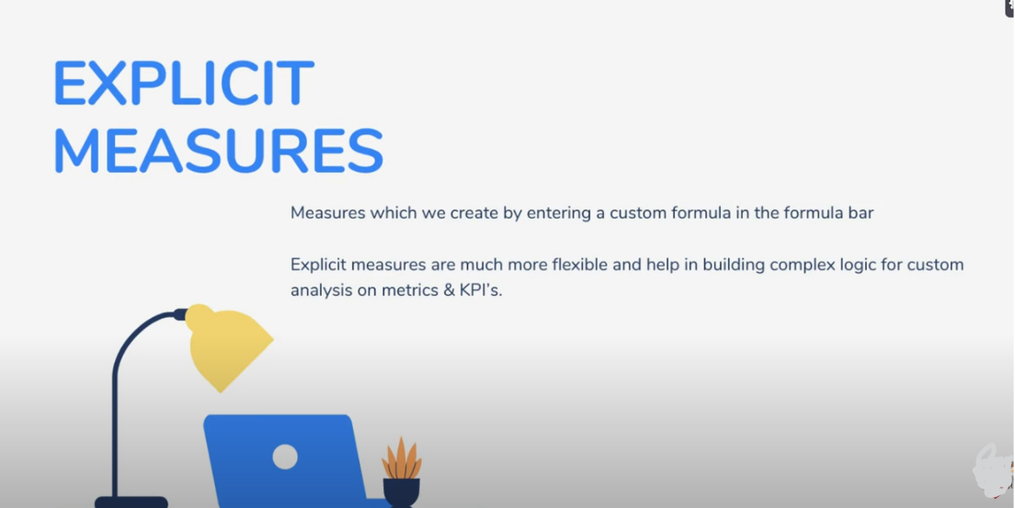

Slide 25


Slide 26
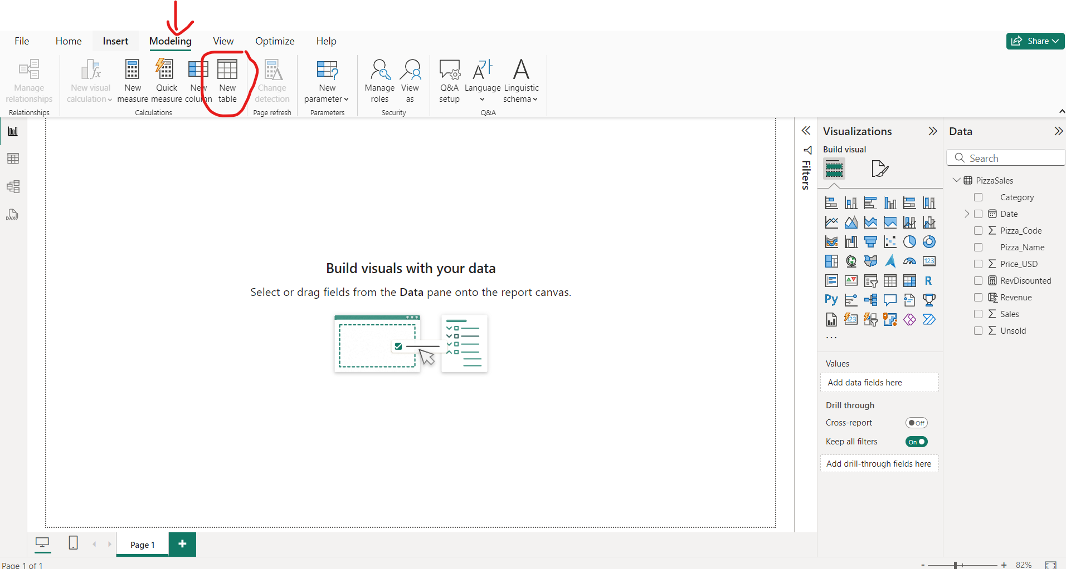

Slide 27
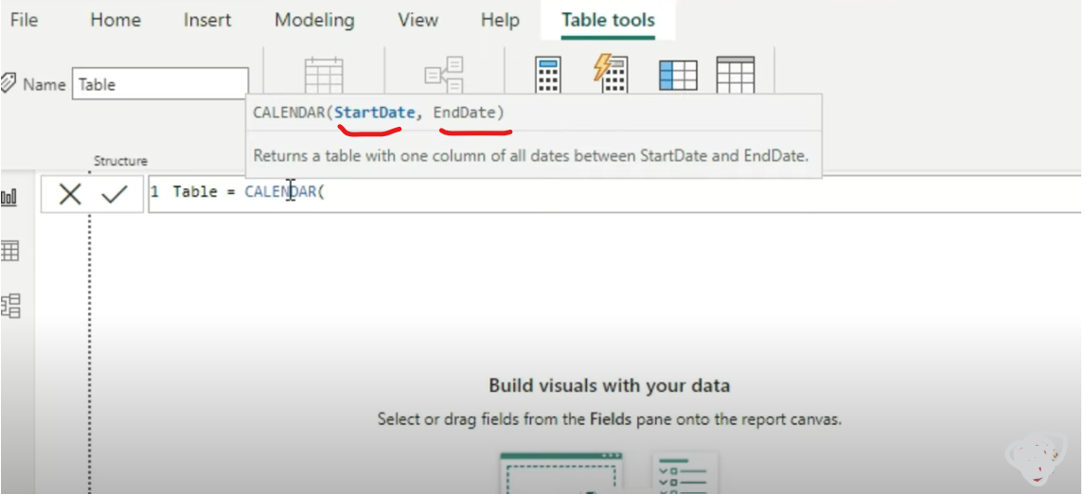
Create A Table Having a Calender Column Recording all your Start and End Dates

Slide 28
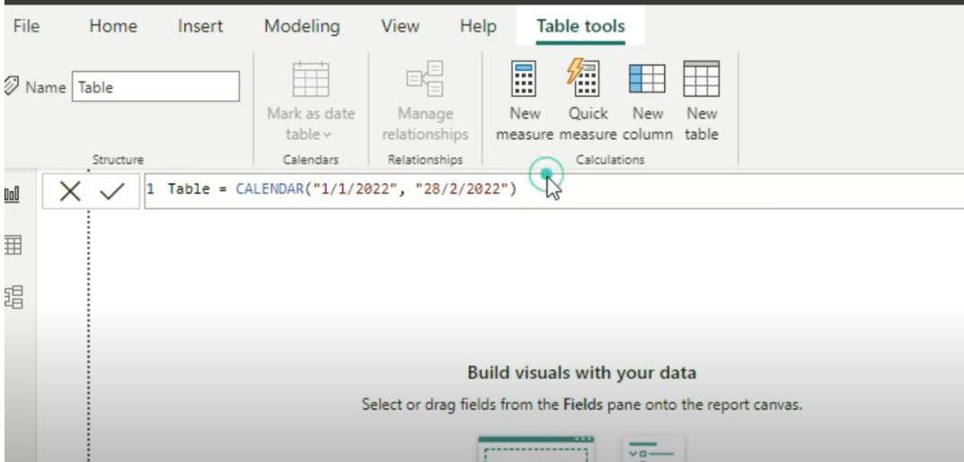
Give a Start and Ending Date

Slide 29
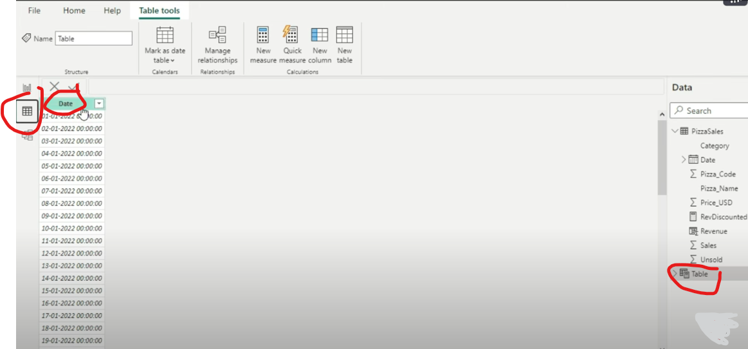
Press Enter and Goto Tabular View

Slide 30
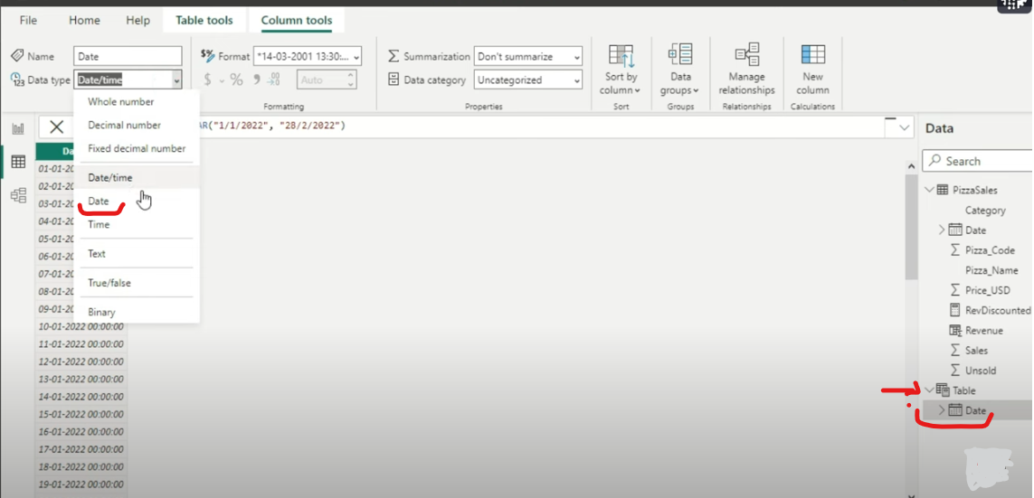
Format the date

Slide 31
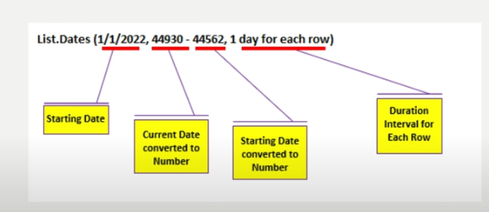

Slide 32
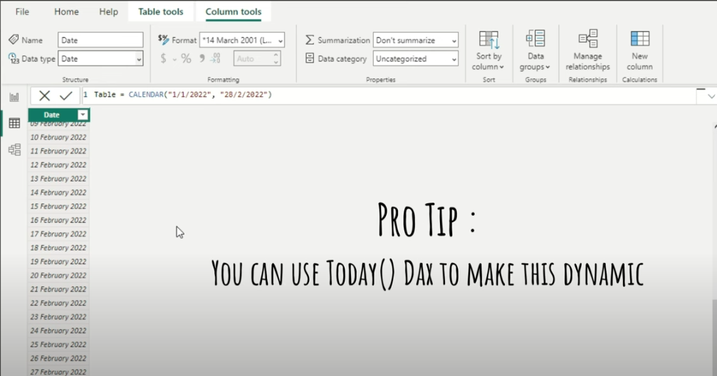
Date format

Slide 33
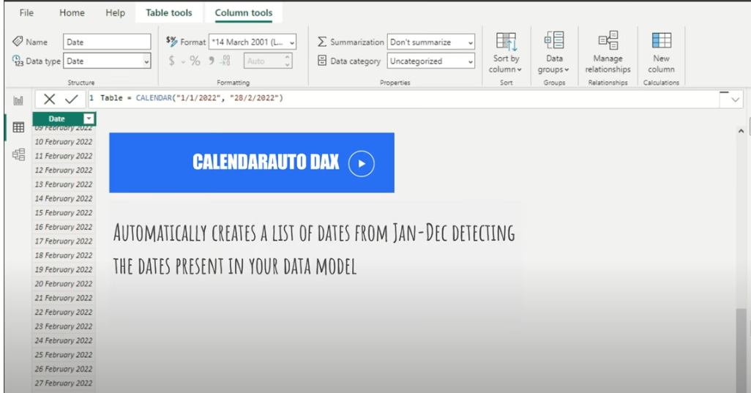
Calendar Auto Dax

Slide 34
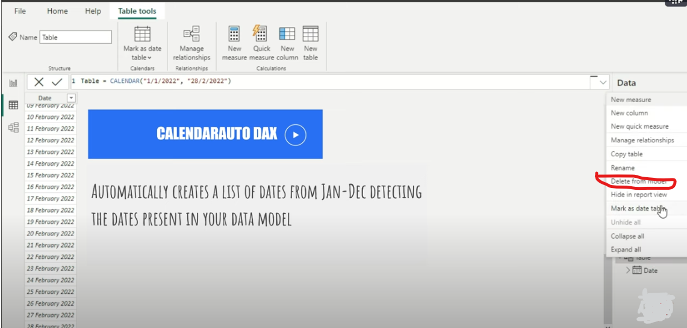
Delete the table

Slide 35
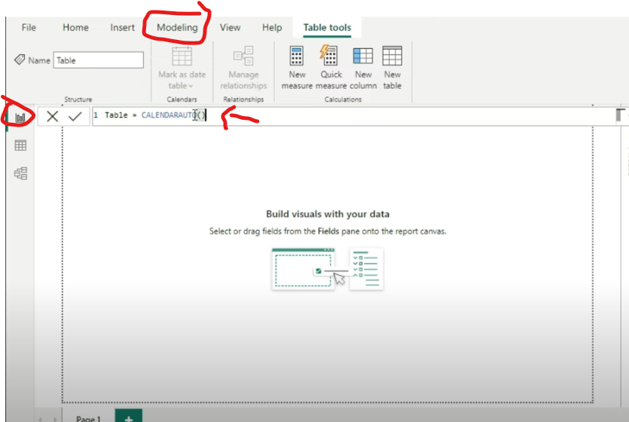
Create a table applying CalenderAuto Function

Slide 36
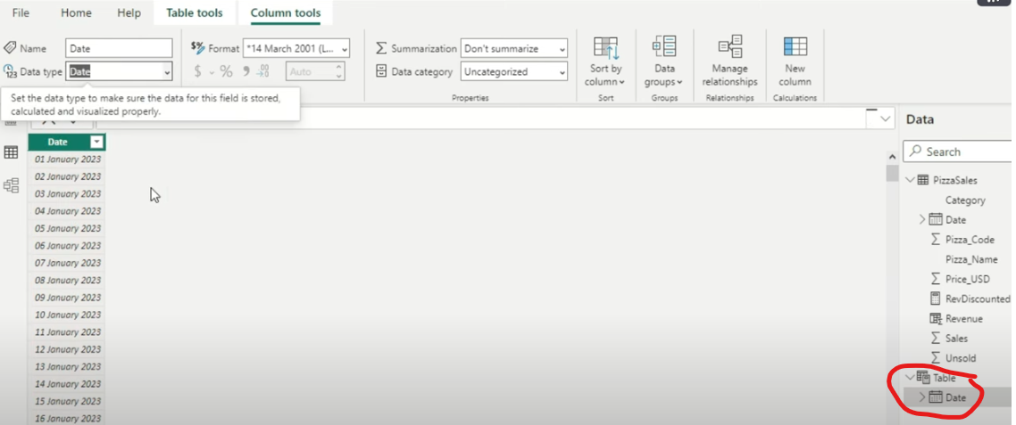
“CalenderAuto” Creates a list of date that is entirely present in your PizzaSales table

Slide 37
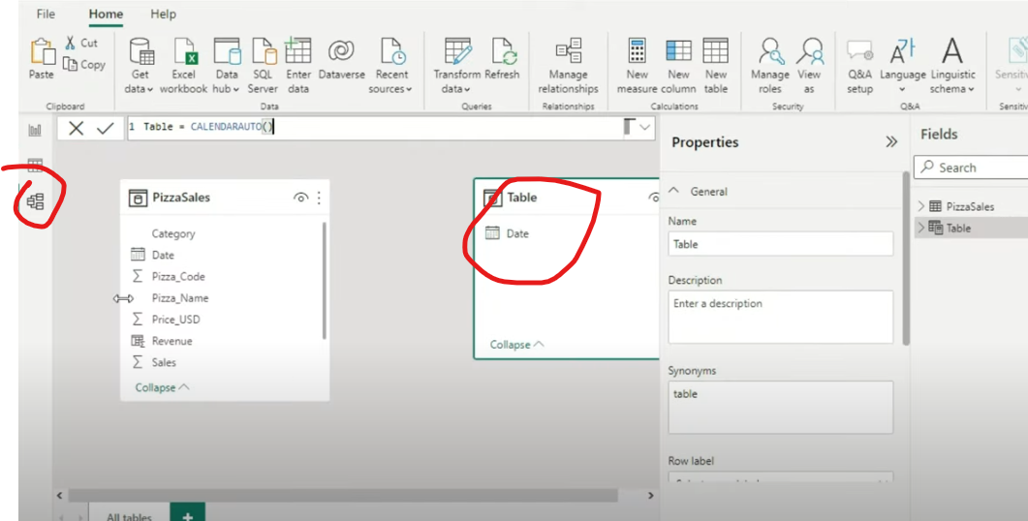
Model View

Slide 38
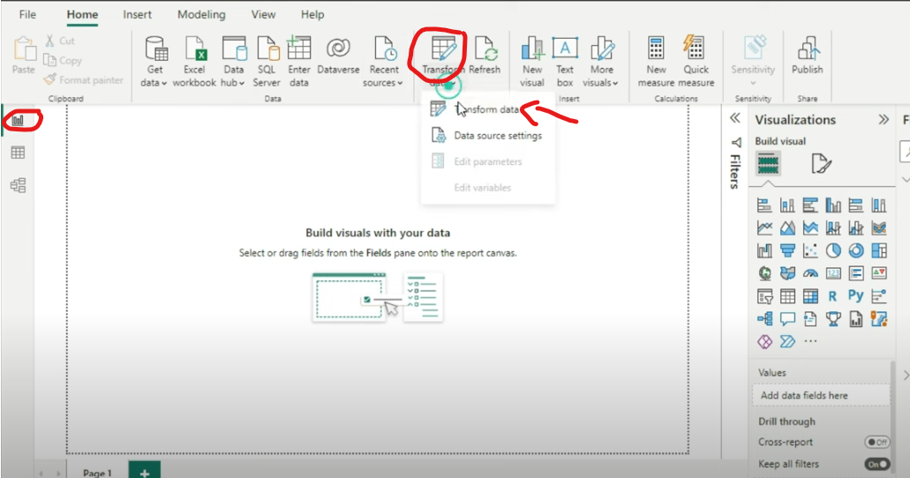
Goto Report -> Transform-> Transform Data

Slide 39
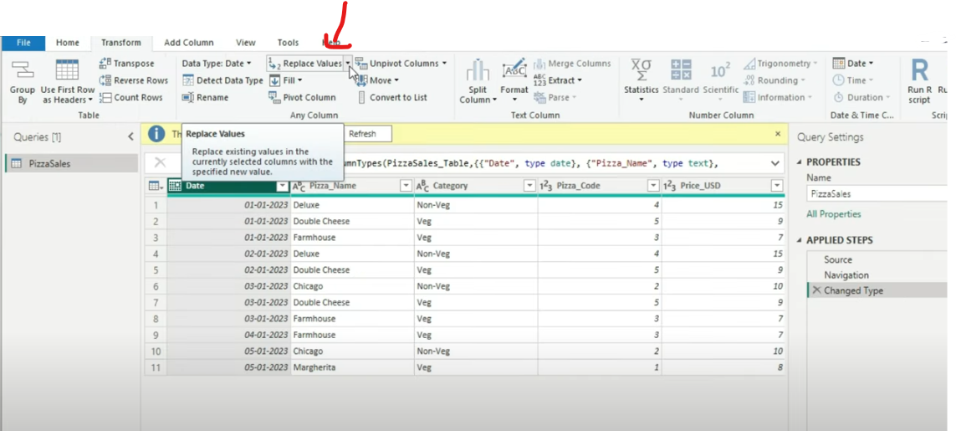
Replace Values of dates ranges

Slide 40
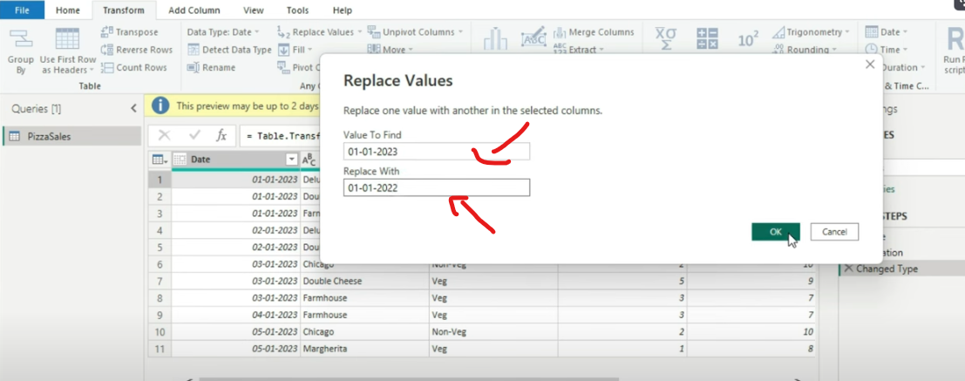
Replace Values

Slide 41
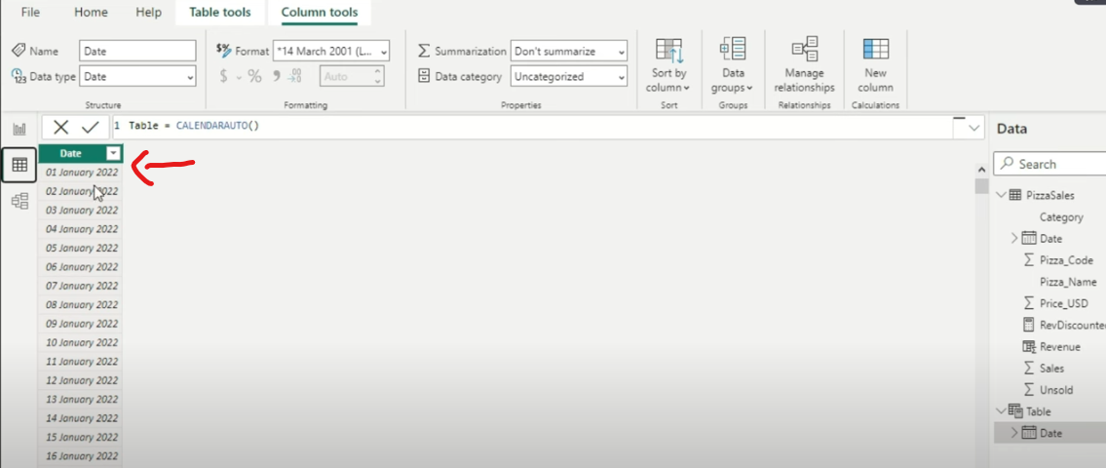
Now After Replacing the date is Starting from 1st of Jan 2022

Slide 42


Slide 43
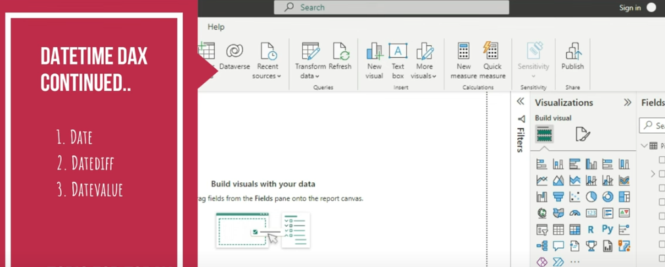

Slide 44


Slide 45
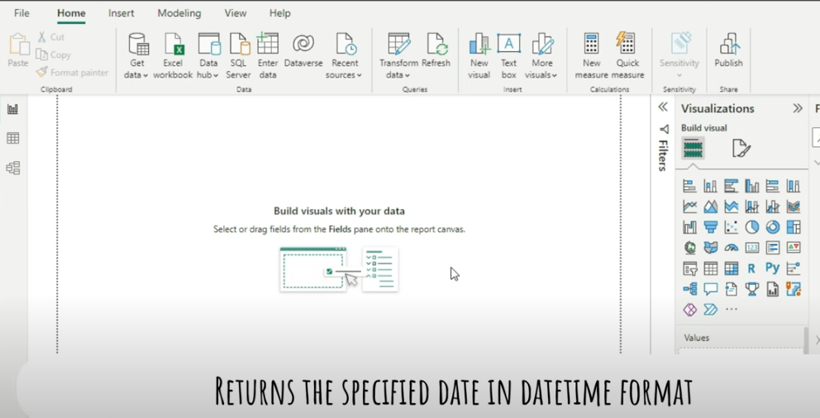

Slide 46
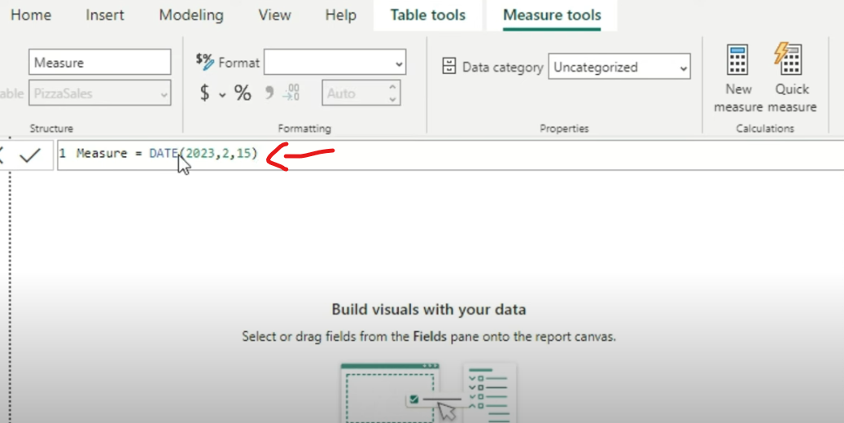
Provide Formula “DATE(Year, Month, Date)”

Slide 47
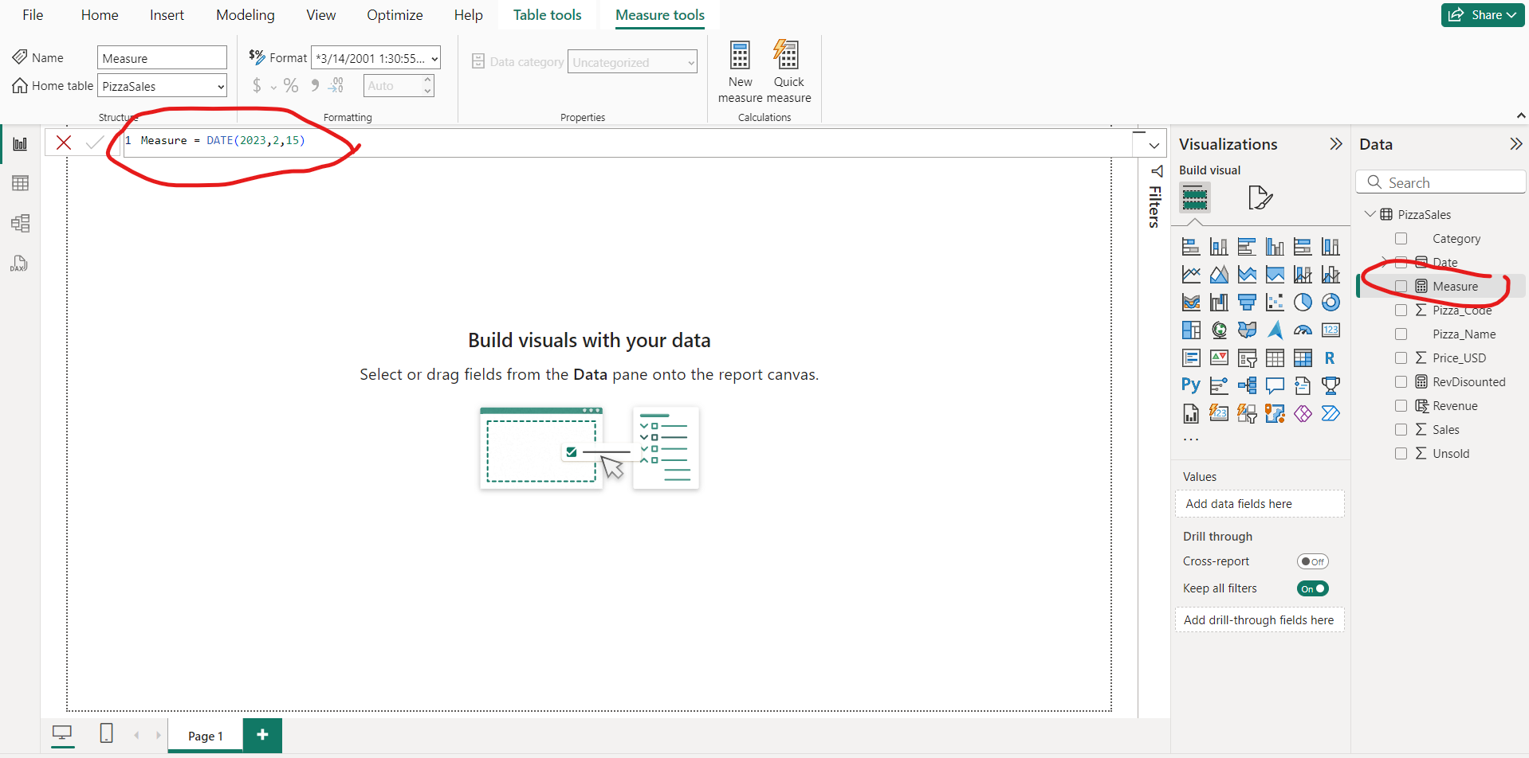
Press Enter Measure is created

Slide 48
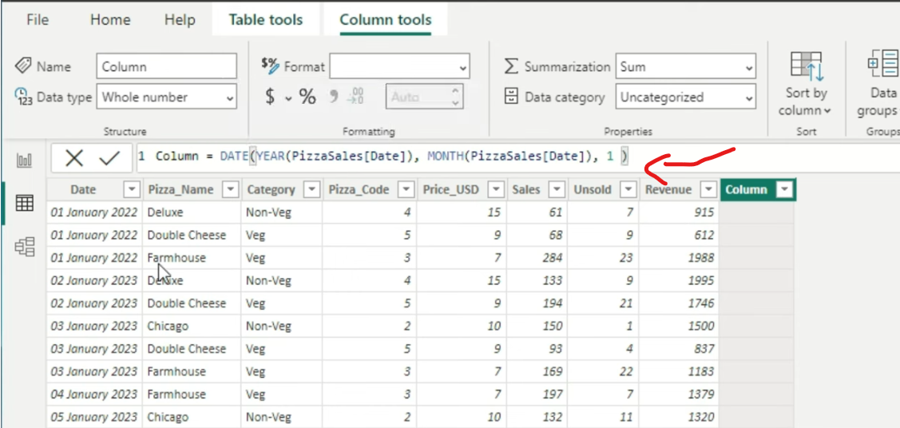

Slide 49
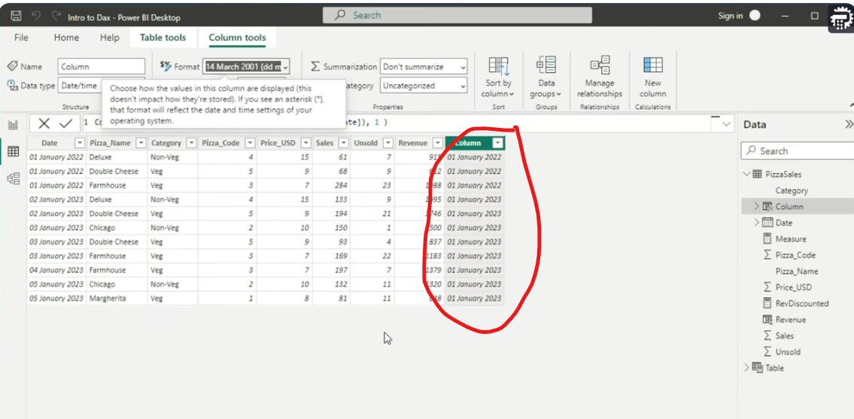
Gives 1st and 1st month of whatever year we have

Slide 50


Slide 51
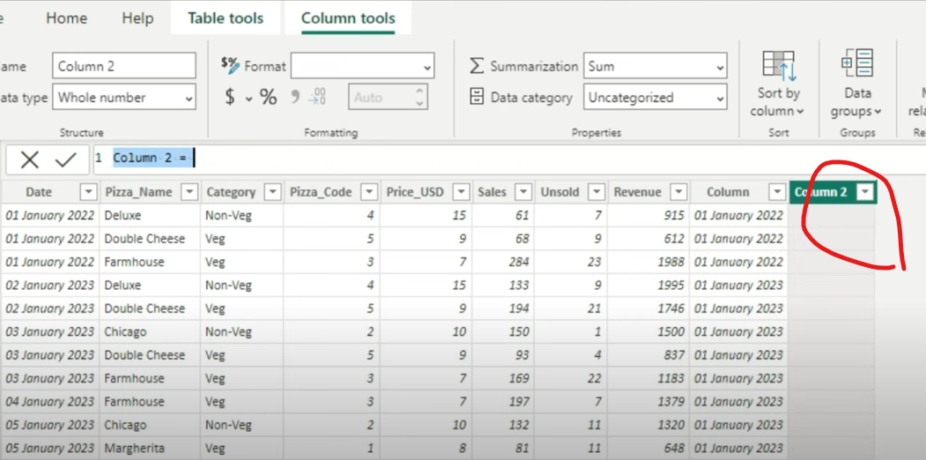
Create a new Column

Slide 52
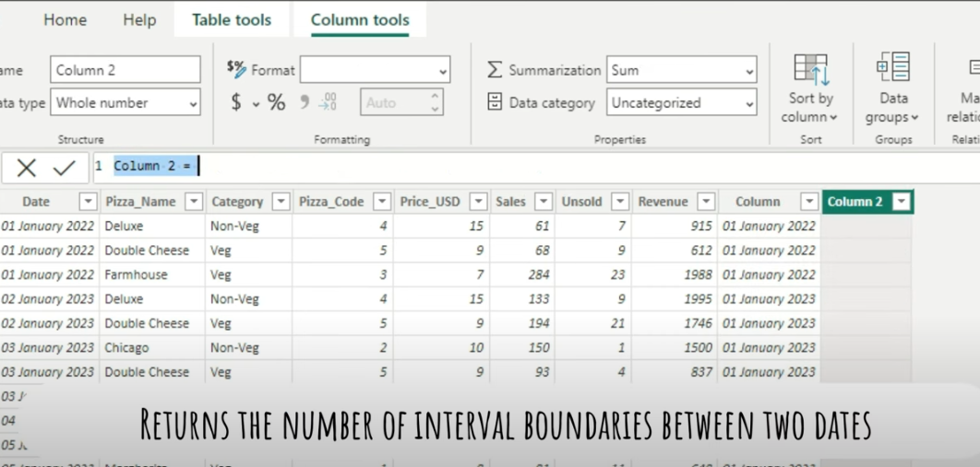

Slide 53
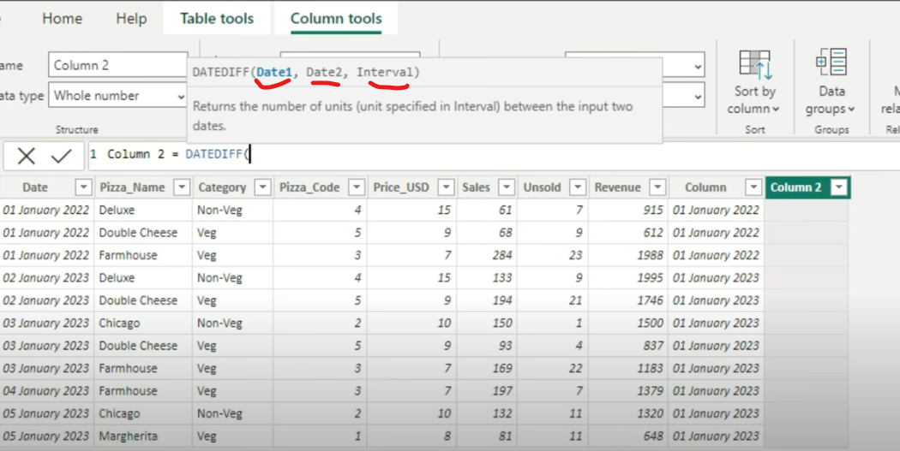
DateDiff

Slide 54
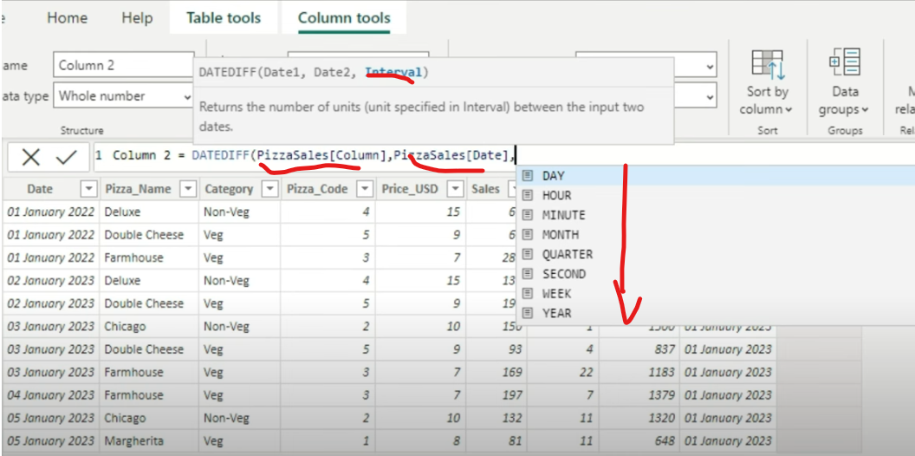
Select Interval between Two date to be either “Days, Hours or Minutes”

Slide 55
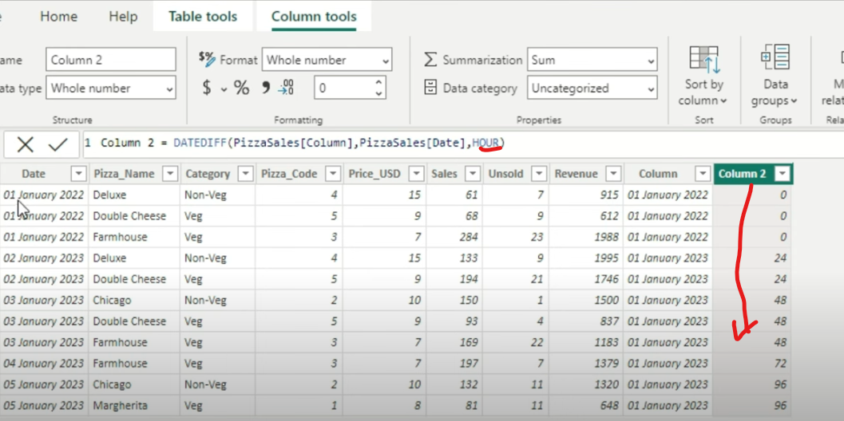
Press enter and DateDiff based column 2 would be created

Slide 56
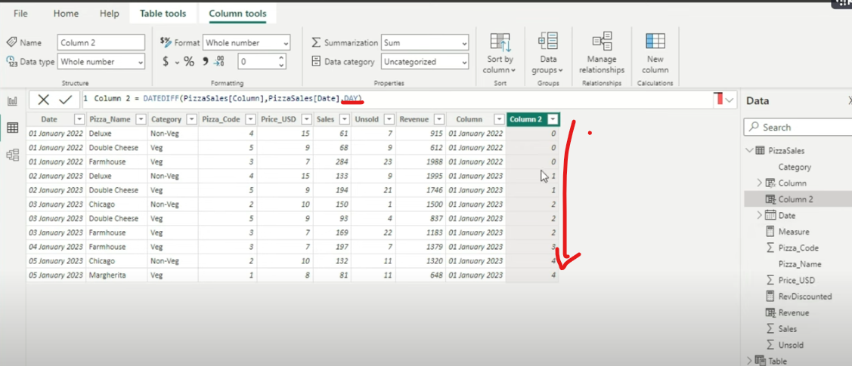
Convert the nterval into “Days” and see what happens

Slide 57


Slide 58
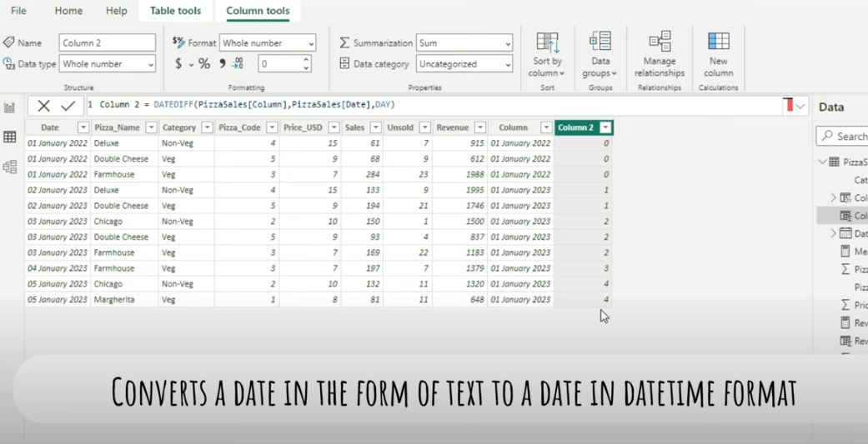

Slide 59
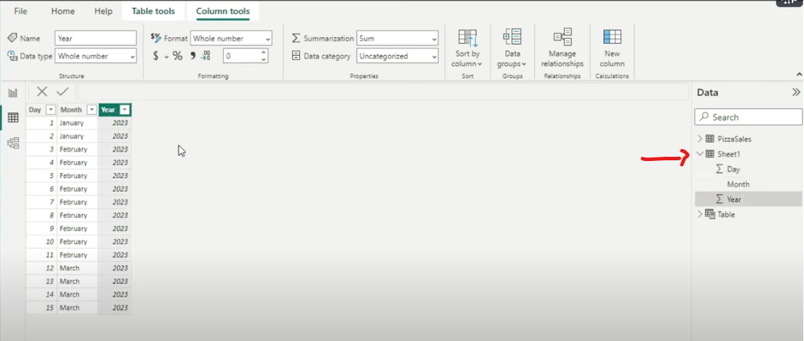
Load sheet 1 dataset

Slide 60
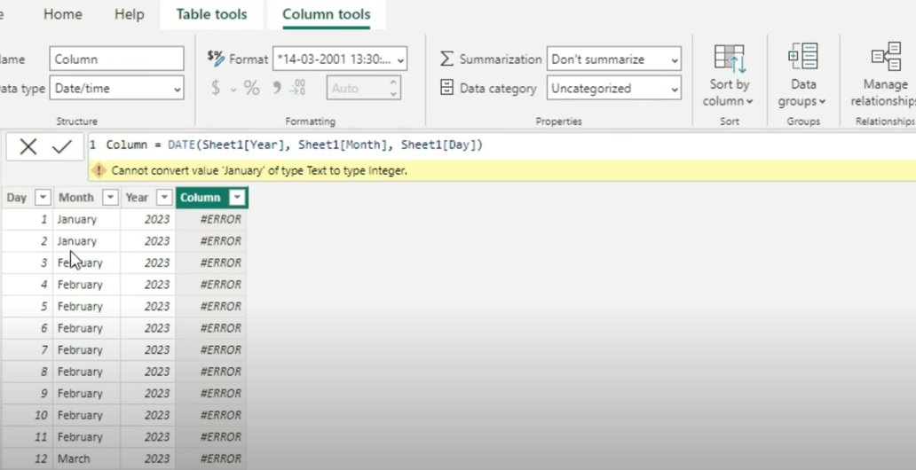
If you try an additional column, Data function cannot Month into text

Slide 61
To remove error Use Datevalue Function

Slide 62
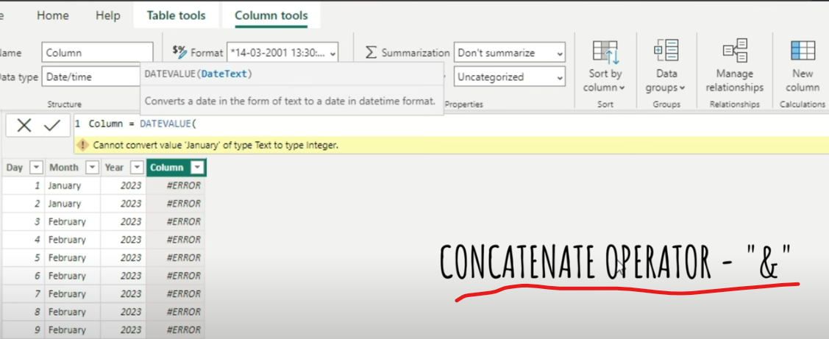
Use DATEVALUE function

Slide 63
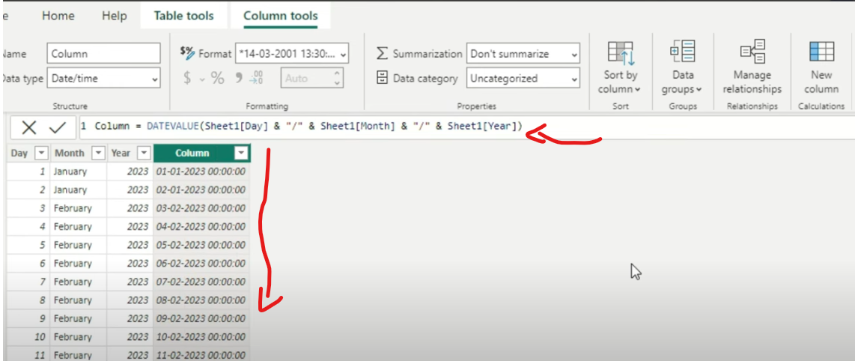

Slide 64
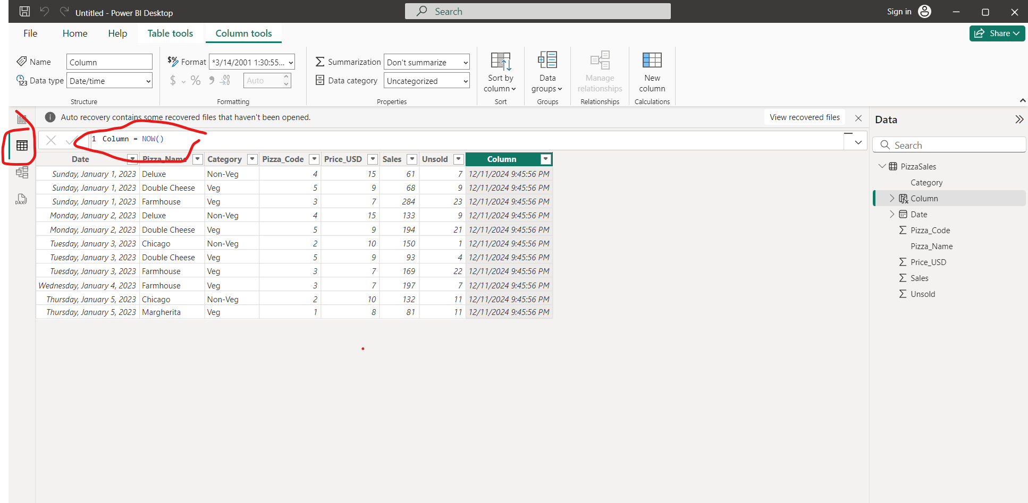
Select TABLE VIEW> PRESS NEW COLUMN AND .. Write “Column= now()”

Slide 65

You can change the format of date time

Slide 66


Slide 67

Its extract the day

Slide 68


Slide 69

+2 adds two month to original date and -1 minuses one month to previous from original

Slide 70


Slide 71


Slide 72

EOMONTH with “zero” provides last day of original month

Slide 73

If we add 1 to EOMONTH it provides one month plus with last day or original month

Slide 74

Make use of negative number to EOMONTH

Slide 75

If you want 1st day of next month from original date

Slide 76


Slide 77


Slide 78

Exclude sat and sun from start to end date use

Slide 79


Slide 80


Slide 81


Slide 82

Create a new Measure

Slide 83

Count would give distinct number of pizza name count

Slide 84

Average measure of pizza sales

Slide 85

Count distinct pizza codes except null

Slide 86


Slide 87


Slide 88

x= Expression

Slide 89

Create a new column and write

Slide 90

Goto dashboard view and disp card and click on new measure

Slide 91


Write a calc measure

Slide 92

You don’t need to explicitly create a column just use sumx and results are similar

Slide 93

Create another column

Slide 94

Create a measure of simple average

Slide 95

Using Averagex you don’t have to create a column

